Slide 1

Python Pandas

Slide 2
Agenda
Introduction to Pandas
Pandas Series
Creating Series
Accessing Series
Filtering Series
Arithmetic Series
Ranking and Sorting
Null Values
Pandas Dataframe
Creating Dataframe
Reading Data from Different Sources
Dataframe Manipulations
Understanding Data
Indexing Dataframe
Sorting and Ranking

Slide 3
Introduction

Slide 4
Introduction
Pandas is a simple yet powerful and expressive tool
It is an open source library in python
It is useful in data manipulation and analysis

Slide 5
Applications of pandas
Applications
Natural Language Processing
Statistics
Analytics
Big Data
Recommendation Engine
Stock Prediction
Data Science

Slide 6
Pandas vs. Numpy
Pandas | Numpy
High level data structures. It provides in-memory 2D table object called data frame. | Low level data structure. (np.array)
More streamlined handling of tabular data, and rich time series functionality. | Supports large multidimensional arrays and matrices.
Data alignment, handling missing data, groupby, merge, and, join methods. | A wide range of mathematical array operations.

Slide 7
Installation
Open terminal program (for Mac user) or command line (for Windows) and install it using following command:
conda install pandas
Or
pip install pandas

Slide 8
Installation
Alternatively, you can install pandas in a jupyter notebook using below code:
!pip install pandas
To import pandas we import it with a shorter name:
import pandas as pd

Slide 9
Components of pandas
Series and dataframe are two primary components of pandas
Series is a one-dimensional labeled array; typically a column, and the DataFrame is a two-dimensional table made up of a group of Series
One Dimensional
Series
Components of Pandas
DataFrame
Multi Dimensional
Panel Data

Slide 10
Pandas Series

Slide 11

Pandas series
Series can be created using the following constructor:
To copy the data
Data can be in the form of ndarray, lists
Data type
for the series
Values must be hashable and have the same length as data

Slide 12
Creating a Series

Slide 13
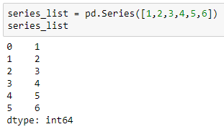
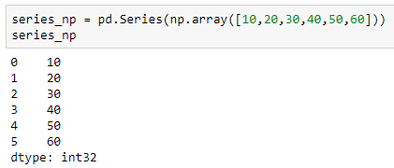
Create a series from a list and numpy array
A pandas series can be created from a python list or numpy array
Using list
Using numpy array

Slide 14
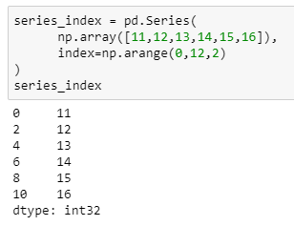
Set index of a series
Specify numeric values as index while creating a series
Pass index parameter
By default, index ranges from 0 to (n-1) for series of length ‘n’

Slide 15
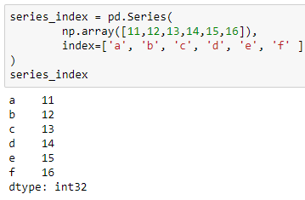
Set index of a series
We can also specify the strings as index values
String as a row index

Slide 16
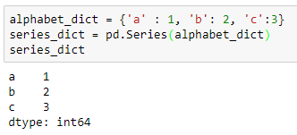
Create a series from a dictionary
Keys as index
Values as row values
The key becomes the row index while the value is the value at that row index

Slide 17
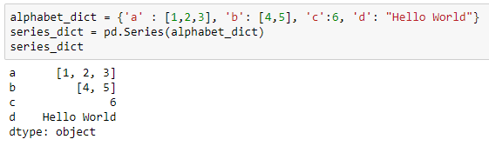
Create a series from a dictionary
If you have multiple values for a single key, those multiple values will take up a single row

Slide 18
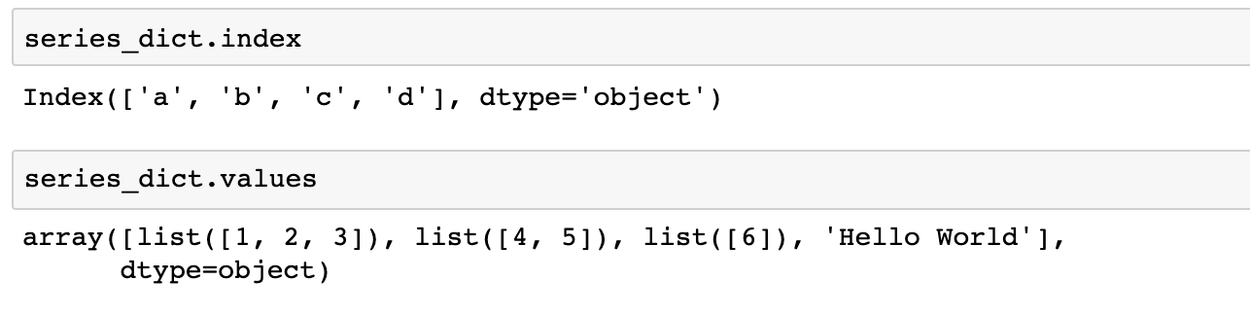
Access series index and values
To display the index names and values of the series use .index and .values respectively

Slide 19
Accessing a Series

Slide 20
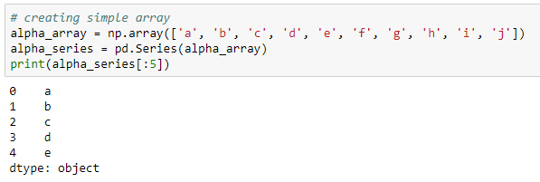
Access elements using position
Access the element in a series using the index operator ‘[]’
Retrieve first five elements

Slide 21
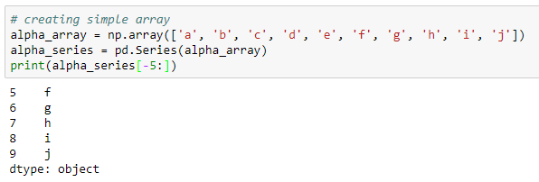
Access elements using position
Retrieve last five elements

Slide 22
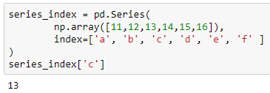
Access elements using index
Use index to access the element

Slide 23
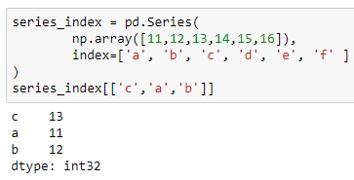
Access elements using index
Retrieve multiple elements using a list of indices

Slide 24
Filtering a Series

Slide 25
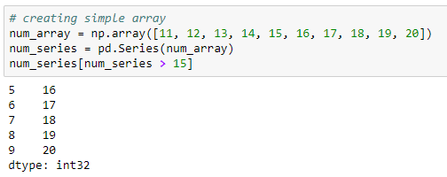
Filter the values
Filter all the values that are greater than 15

Slide 26
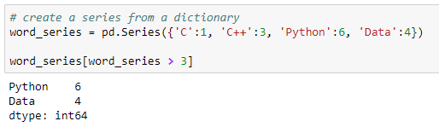
Filter the values
Filter all the words whose length is greater than 3

Slide 27
Arithmetic Operations

Slide 28
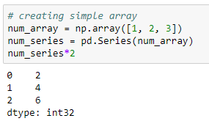
Scalar multiplication
Use ‘*’ operator to perform multiplication
One can also use the series .multiply() method to perform the multiplication operation

Slide 29
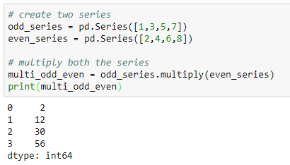
Multiplication of two series
The series .multiply() method returns the element-wise multiplication of the two series

Slide 30
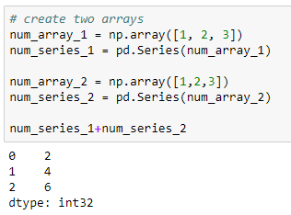
Addition of two series
Use ‘+’ operator to perform addition

Slide 31
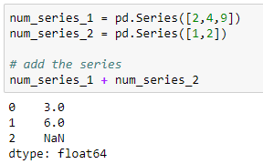
Addition of two series
If the length of the two series are different, then the addition of such series shows the null values (NaN) for the indexes where the values are missing in one of the series

Slide 32
Ranking and Sorting of a Series

Slide 33
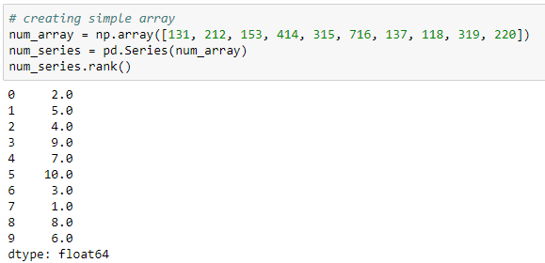
Rank the series
Returns the rank of the underlying data
By default, the rank() returns the ranking in ascending order

Slide 34
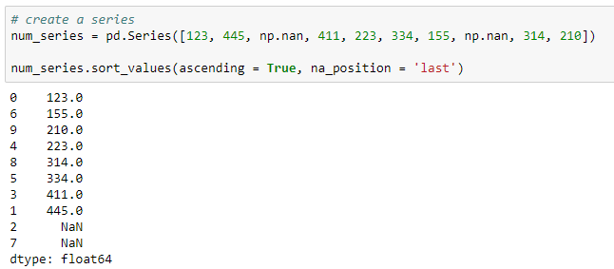
Sort the series by values
The sort_values() method sorts the series by values in the series
Returns the null values in the last position

Slide 35
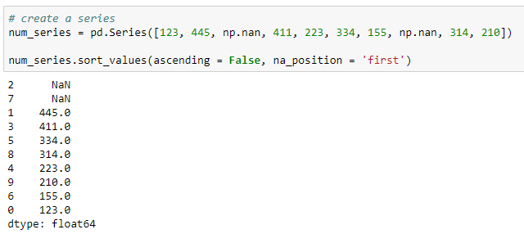
Sort the series by values
Returns the null values in the first position
‘ascending = False’ sorts the series in descending order

Slide 36
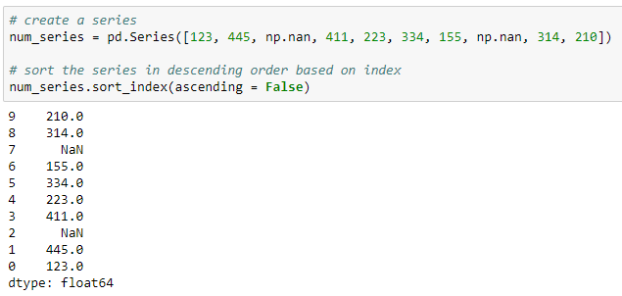
Sort the series by index
Sort the series by index

Slide 37
Check for Null Values

Slide 38
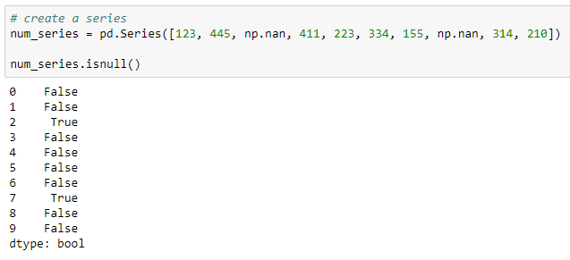
Check for null values
The .isnull() returns the boolean output indicating the presence of null values
‘True’ in the output indicates that the corresponding value is null

Slide 39
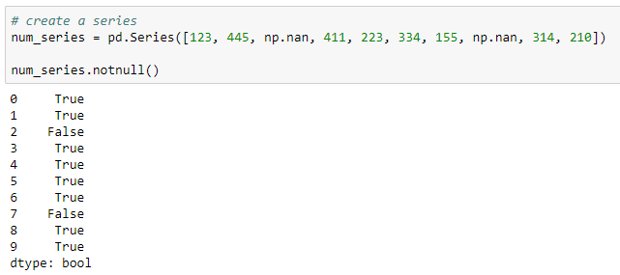
Check for null values
The .notnull() returns the boolean output indicating the presence of non-null values
‘False’ in the output indicates that the corresponding value is null

Slide 40
Pandas DataFrame

Slide 41
Pandas DataFrame
A DataFrame is two dimensional data structure. i.e., data is aligned in the tabular manner (rows and columns)
Features of the DataFrame:
Columns can be of different types
Size is mutable
Axes are labeled (rows and columns)
Arithmetic operations on rows and columns

Slide 42
Creating a DataFrame

Slide 43
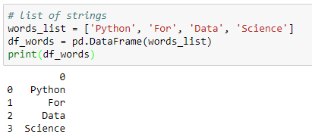
Create a DataFrame from a single list
Pass a list as a column in ‘df’
As no column name is passed, by default it returns ‘0’ as column name

Slide 44
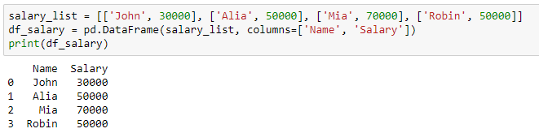
Create a DataFrame from a list of lists
Pass the list of column names

Slide 45
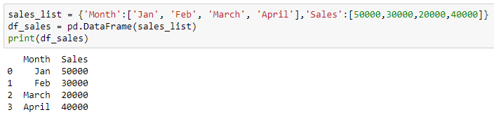
Create a DataFrame from a dictionary
Keys of the dictionary as column names

Slide 46
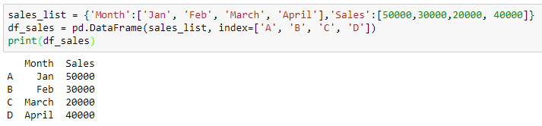
Create a DataFrame with index
Pass a list of index

Slide 47
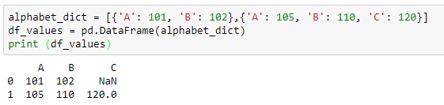
Create a DataFrame from a list of dictionaries
Dictionary as a row

Slide 48
Reading Data from Different Sources

Slide 49
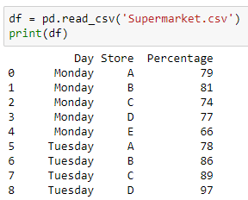
Read the data from csv file
Use the read_csv() method from pandas to read the data from csv file

Slide 50
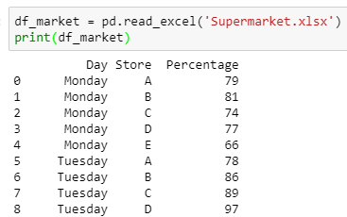
Read the data from xlsx file
Use the read_excel() method from pandas to read the data from xlsx file

Slide 51
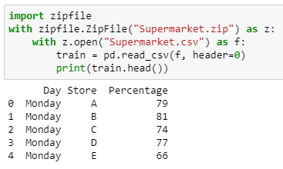
Read the data from zip file
Read the zip file
Open csv file inside the zip file
Read the csv file

Slide 52
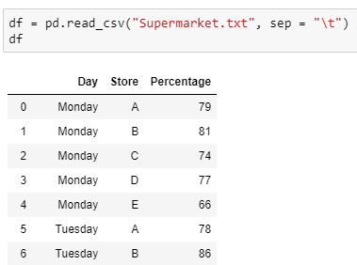
Read the data from text file
Use the read_csv() method from pandas to read the data from text file

Slide 53
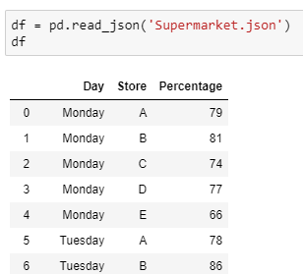
Read the data from json file
Use the read_json() method from pandas to read the data from json file

Slide 54
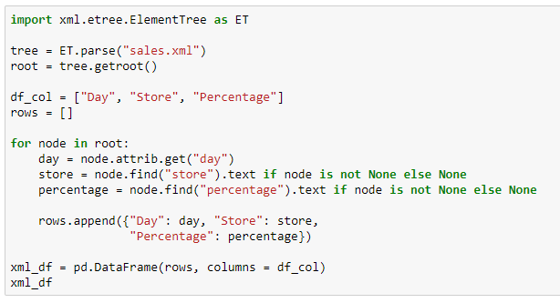
Read the data from xml file
Import package to read xml file
Extract the xml file
Assign column names of the output DataFrame
Append each observation in the data to ‘rows’
Create a DataFrame ‘xml_df’

Slide 55
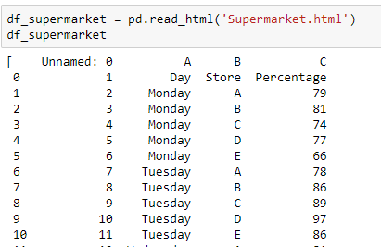
Read the data from html file
Use the read_html() method from pandas to read the data from html file

Slide 56
DataFrame Manipulations

Slide 57
Read the data from xlsx file
We use the following DataFrame for further explanations

Slide 58
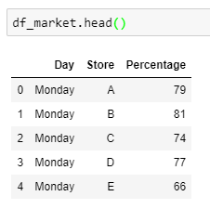
Display the first five rows
The head() method displays the first five rows of the data

Slide 59
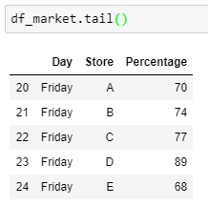
Display the last five rows
The tail() method displays the last five rows of the data

Slide 60
Understanding the Data

Slide 61

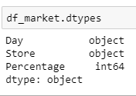
Understand the data
Check the dimension of the data using the shape attribute
Check the data type of each variable in the data using the dtypes attribute

Slide 62
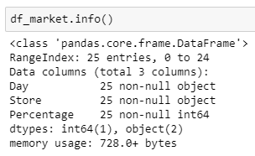
Understand the data
The info() method returns the information about the shape, data type and null values in the data
Here, ‘df_market’ has 3 variables with 25 non-null observations in each
There are 2 categorical variables (‘Day’ and ‘Store’) and one numeric variable (Percentage)

Slide 63
Indexing the DataFrame

Slide 64
Access elements in the DataFrame
Indexing is frequently required in DataFrame. It may serve the purpose of cross tables or pivot tables
We can either use the .iloc[], the .loc[] or some conditions to retrieve the elements
The .iloc[] allows us to retrieve the rows and columns by position, and the .loc[] allows us to retrieve the elements by the column or row name

Slide 65
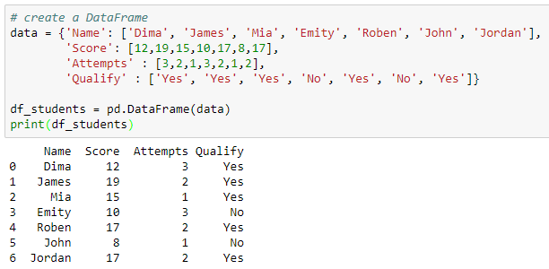
Access elements in the DataFrame
Example: Create a DataFrame of six students as shown below

Slide 66
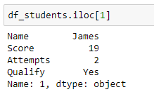
Access elements in the DataFrame
Retrieve the 2nd row by using the .iloc[]

Slide 67
Access elements in the DataFrame
Retrieve the name of the first student using the .iloc[]
Retrieve ‘Name’ from the series
‘0’ index returns the first row as series

Slide 68
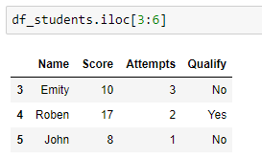
Access elements in the DataFrame
Retrieve the 4th, 5th, and 6th row in the DataFrame using the .iloc[]

Slide 69
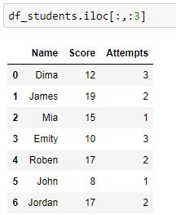
Access elements in the DataFrame
Select first three columns by using the position of the columns

Slide 70
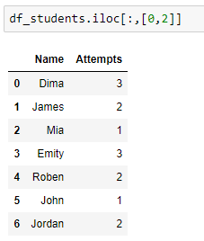
Access elements in the DataFrame
Find the number of attempts corresponding to each student using the .iloc[]

Slide 71
Access elements in the DataFrame
The .loc[] selects the data by the label of the rows and column
Retrieve the score of the second student using the .loc[]
Column label
Row index

Slide 72
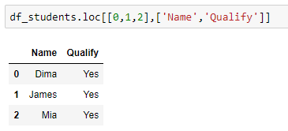
Access elements in the DataFrame
Retrieve the columns ‘Name’ and ‘Qualify’ for first three students

Slide 73
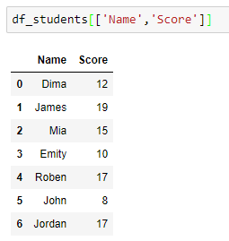
Access elements in the DataFrame
Retrieve the score for all the students along with their name using the .loc[]

Slide 74
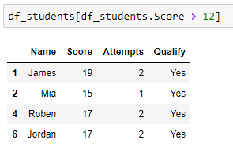
Access the elements using different conditions
Retrieve the information of the student whose score is more than 12

Slide 75
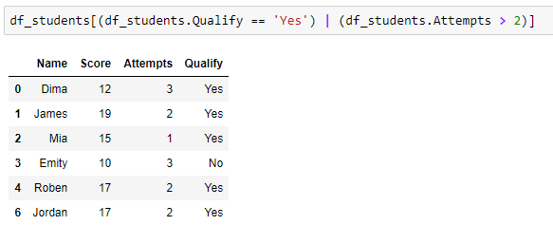
Access the elements using different conditions
Retrieve the students who either have more than two attempts or have qualified the exam

Slide 76
Sorting the DataFrame

Slide 77
Read the data from xlsx file
We use the following dataframe for further manipulations

Slide 78
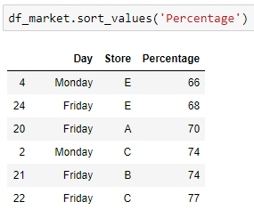
Sort the DataFrame
Sort the DataFrame by values in the column ‘Percentage’

Slide 79
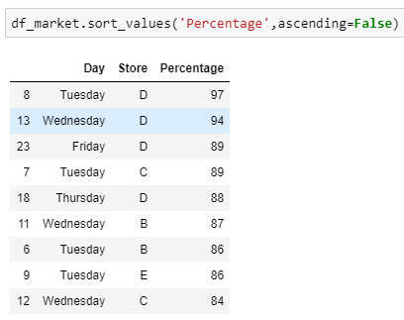
Sort the DataFrame
Sort the DataFrame by values in the column ‘Percentage’ in the descending order

Slide 80

Sort the DataFrame
While sorting the DataFrame by multiple columns, the .sort_values() first sorts the first passed variable and then the next variable
In this case, the function first sorted the variable ‘percentage’ and then the variable ‘store’

Slide 81

Sort the DataFrame
Sort the DataFrame by values in the columns ‘Store’ and ‘Percentage’

Slide 82

Sort the DataFrame
Sort the DataFrame with the condition (Percentage > 85), by index using the sort_index() method

Slide 83
Ranking in the DataFrame

Slide 84
Access elements in the DataFrame
Example: Create a DataFrame of six students as shown below

Slide 85

Rank the DataFrame
Rank the DataFrame by values in the column ‘Score’ using the parameter, method = ‘min’
If the score is same for two or more observations, then the ‘min’ method assigns the minimum rank to all the equal scores
Here it assigned the rank ‘5’ to the score = 17

Slide 86

Rank the DataFrame
Rank the DataFrame by values in the column ‘Score’ using the parameter, method = ‘max’
If the score is same for two or more observations, then the ‘max’ method assigns the maximum rank to all the equal scores
Here it assigned the rank ‘6’ to the score = 17

Slide 87

Rank the DataFrame
Rank the DataFrame by values in the column ‘Score’ using the parameter, method = ‘dense’
This method does not skip a rank, like the ‘min’ and ‘max’ method
Here, it assigned the rank ‘5’ to score = 17, and ‘6’ to next greater score = 19

Slide 88

Rank the DataFrame
Rank the DataFrame by values in the column ‘Score’ in descending order
By default, the method is ‘average’ in the .rank(), and it assigns the average rank to the equal values
Here, it assigned the rank ‘5.5’ to the same score = 17

Slide 89
Thank You

